Slide 1
Context-Free Languages

Slide 2

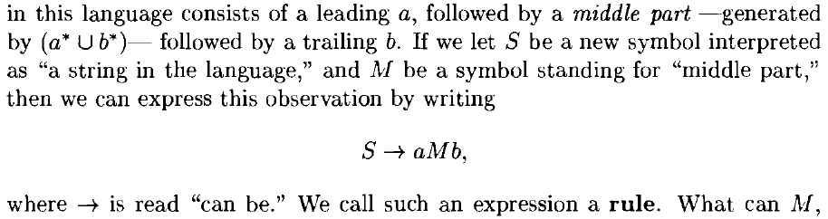
Context-Free Grammars
Language recognizer
a device that accepts valid strings
language generator
construct valid strings
operation limited by a set of rules
Eg,

Slide 3




Context-Free Grammars

Slide 4
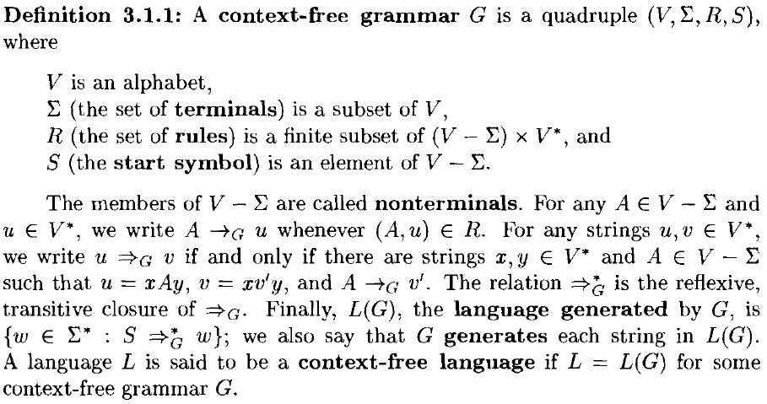
Context-Free Grammars

Slide 5
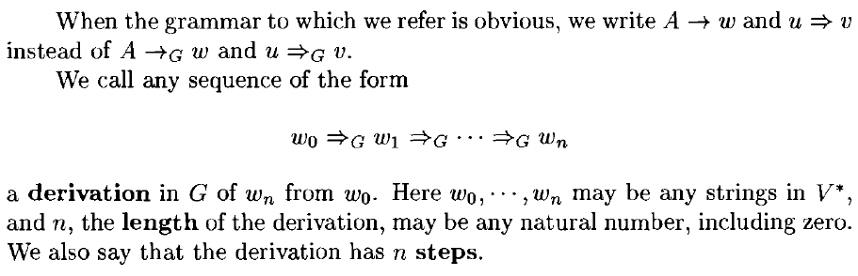
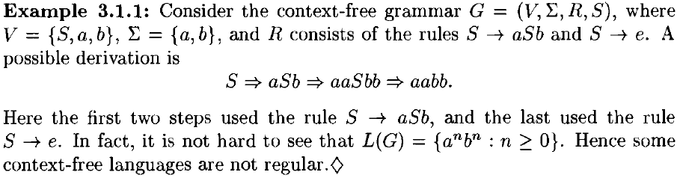

Slide 6
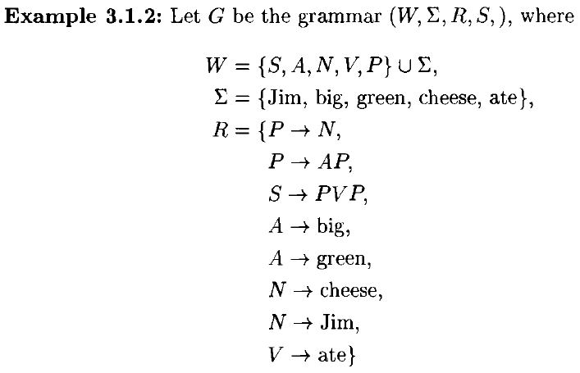



Slide 7
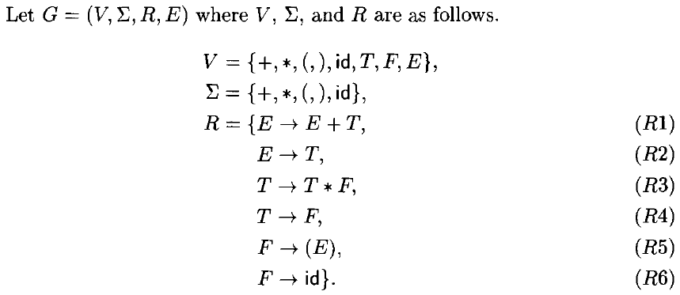
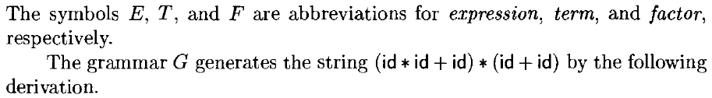

Slide 8
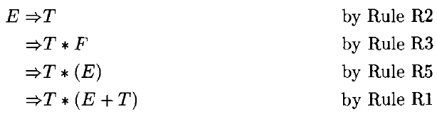
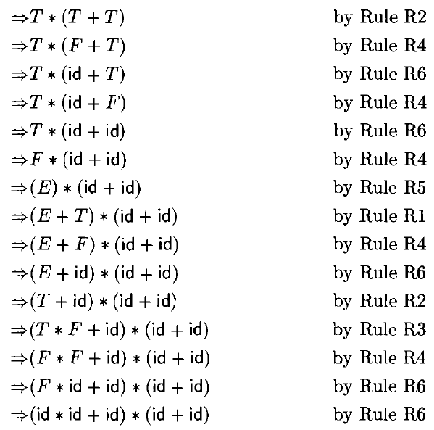

Slide 9
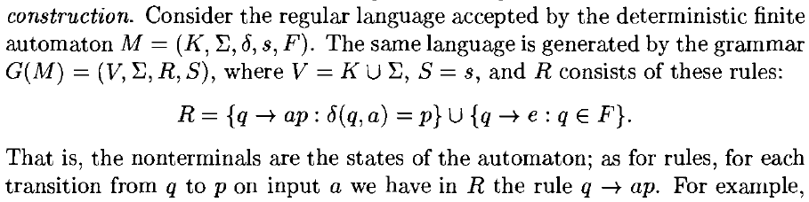
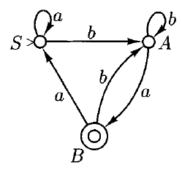
Finite Automata to CFG

Slide 10
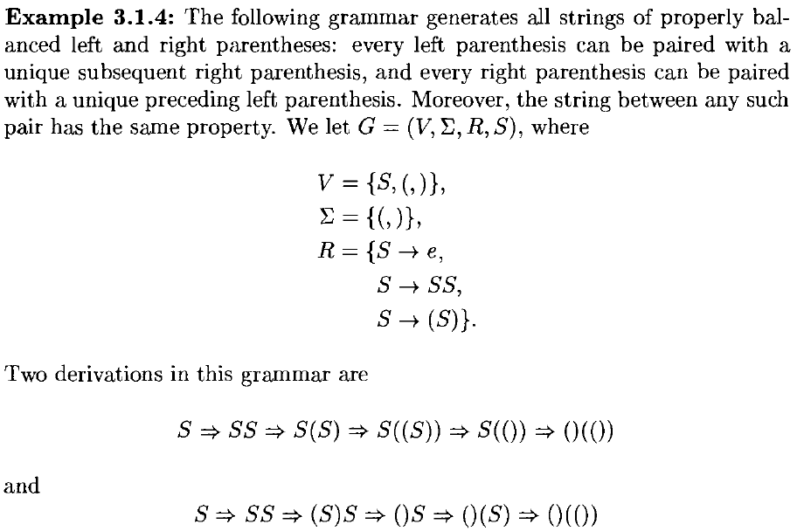

Slide 11
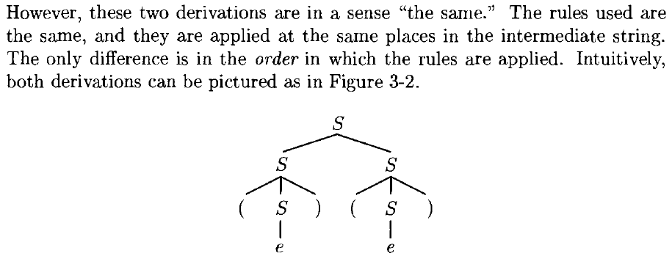
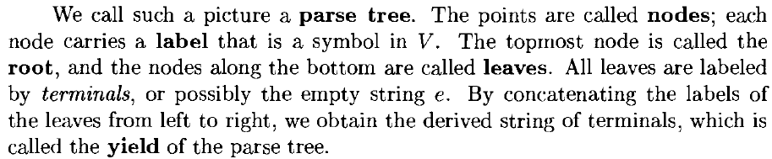
Parse Trees

Slide 12
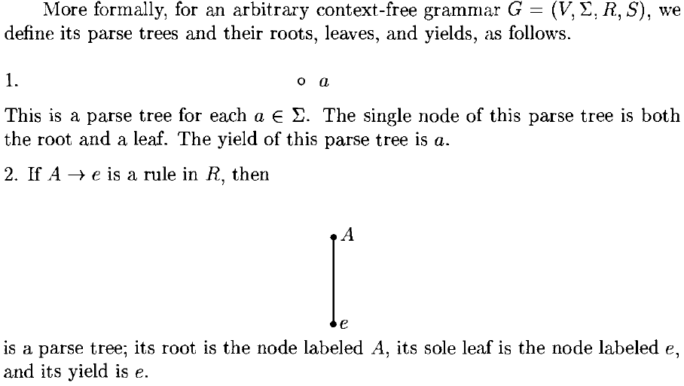

Slide 13
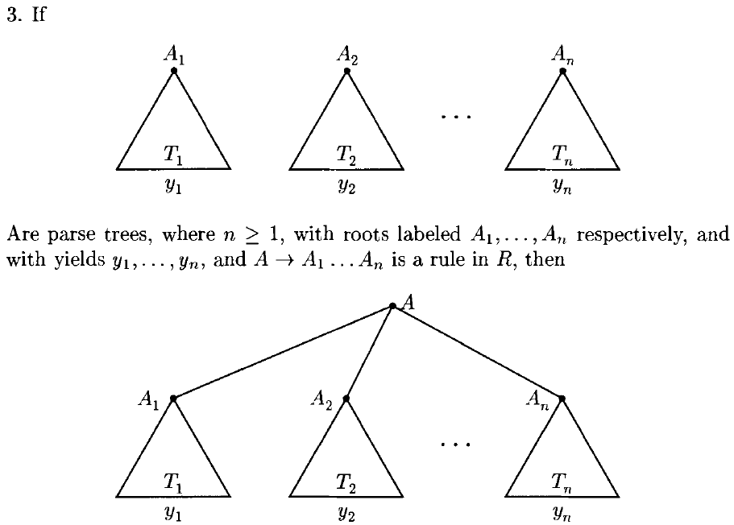

Slide 14
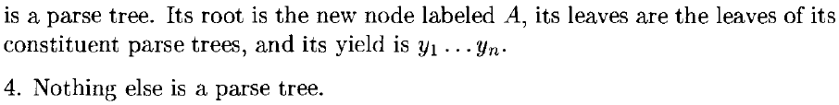

Slide 15
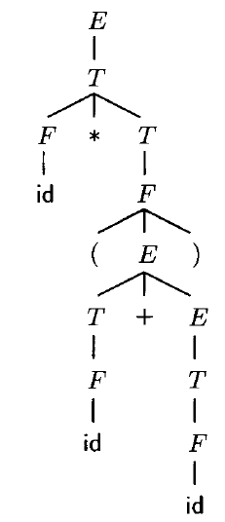
Example

Slide 16
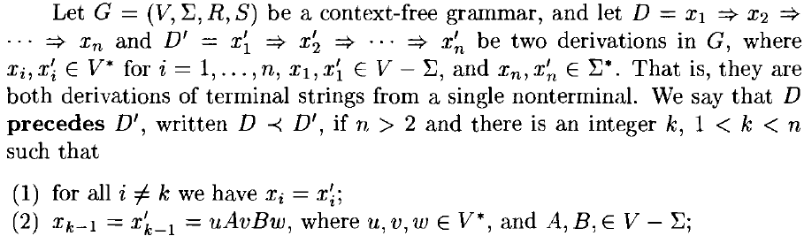
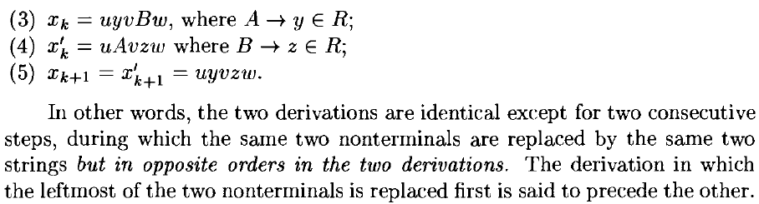

Slide 17
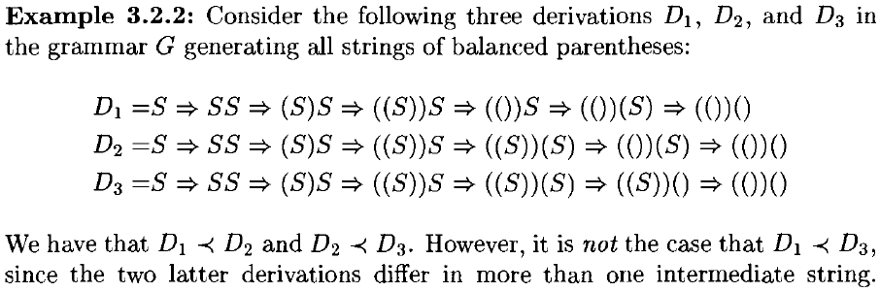


Slide 18
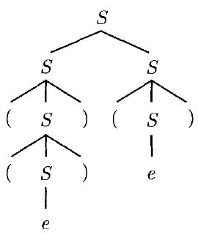
Parse Tree

Slide 19
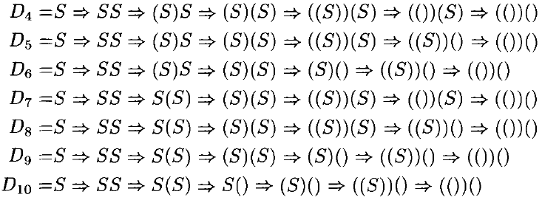
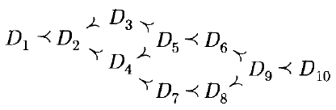

Slide 20
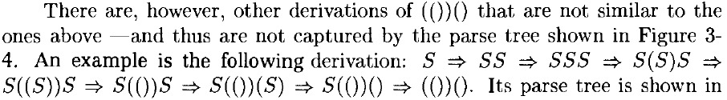
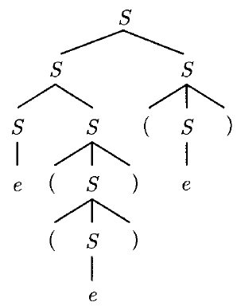

Slide 21
Leftmost and Rightmost derivation
A leftmost derivation can be obtained as follows.
Starting from the label of the root A, repeatedly replace the leftmost nonterminal in the current string according to the rule suggested by the parse tree.
Similarly, a rightmost derivation is one that does not precede any other derivation
It is obtained from the parse tree by always expanding the rightmost nonterminal in the current string.
Each parse tree has exactly one leftmost and exactly one rightmost derivation.

Slide 22
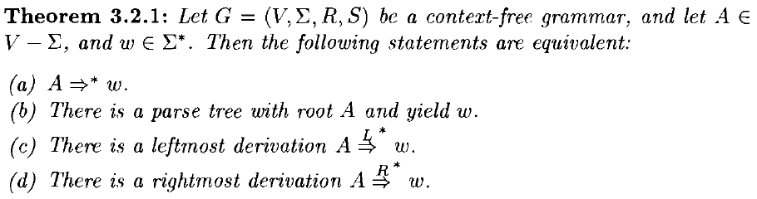

Slide 23
Ambiguity
There may be a string in the language generated by a context-free grammar with two derivations that are not similar -that is to say, with two distinct parse trees
Example: G'

Slide 24
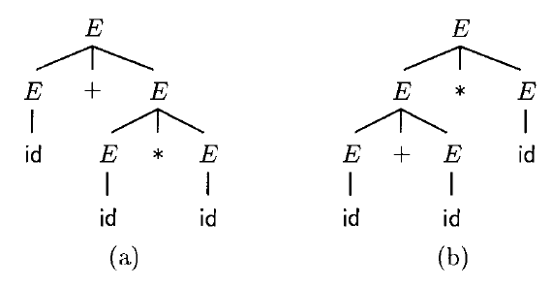
Ambiguity
id + id * id
Grammars such as G', with strings that have two or more distinct parse trees, are called ambiguous.

Slide 25
Ambiguity
Assigning a parse tree to a given string in the language is an important first step towards understanding the structure of the string, ultimately its "meaning.“
Ambiguous grammars are of no help in parsing, since they assign no unique parse tree –no unique "meaning" - to each string in the language.
In fact, there are context-free languages with the property that all context-free grammars that generate them must be ambiguous. Such languages are called inherently ambiguous.
Fortunately, Programming Languages are never inherently ambiguous.

Slide 26

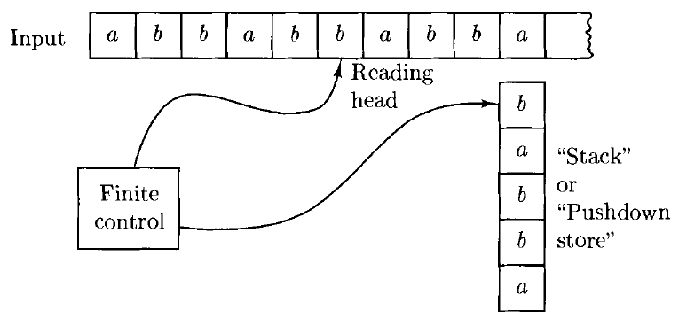
Pushdown Automata

Slide 27
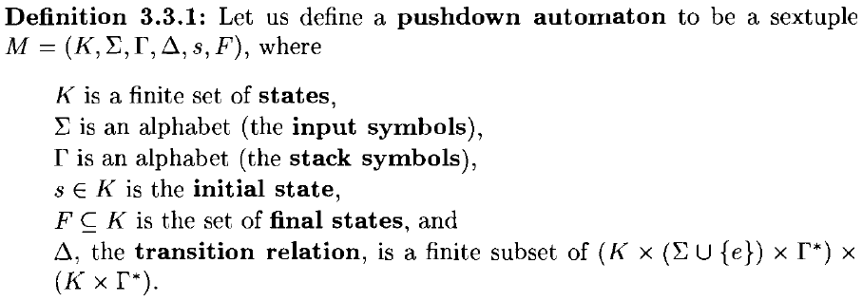
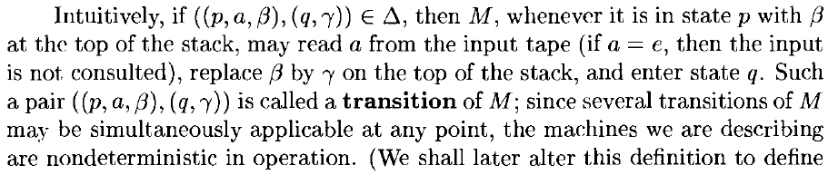


Slide 28
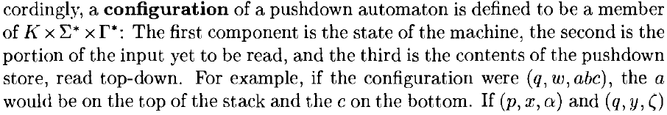
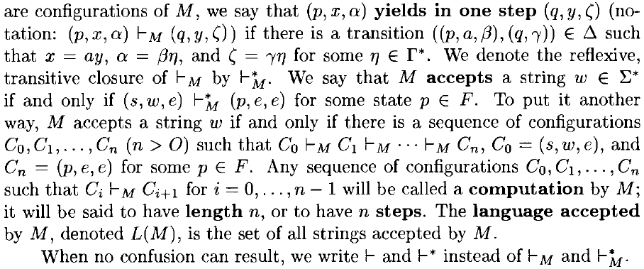
Configuration

Slide 29
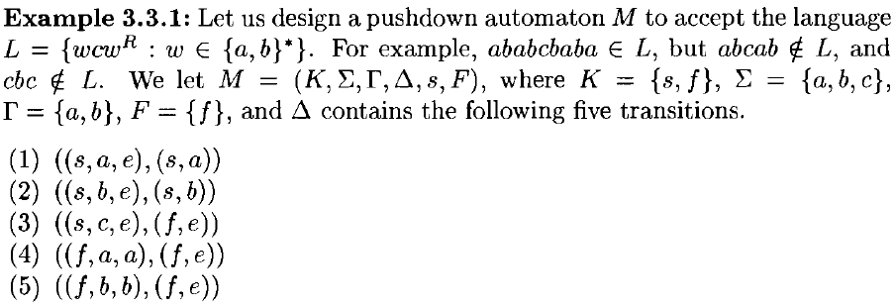
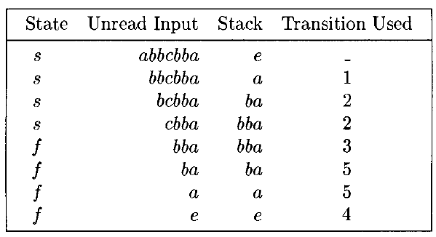

Slide 30


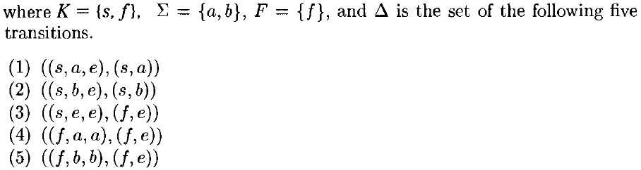

Slide 31
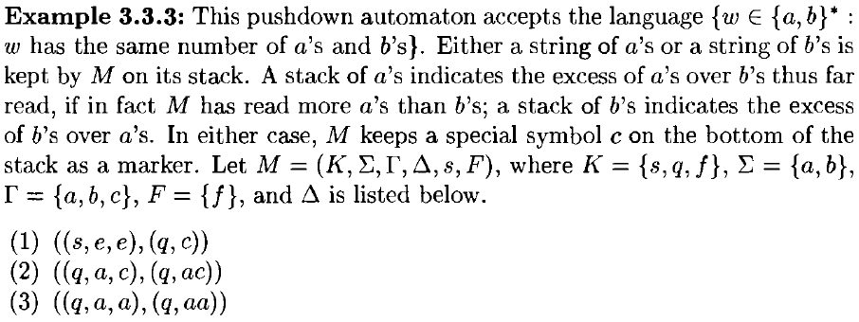
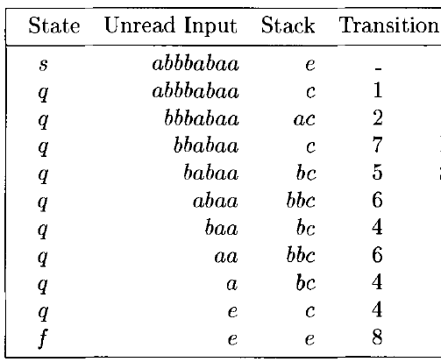
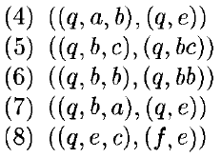

Slide 32
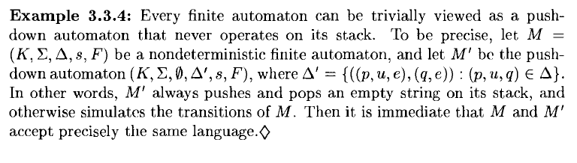
Finite Automata as Pushdown Automata

Slide 33
Pushdown Automata and Context-Free Grammars
Theorem: The class of languages accepted by pushdown automata is exactly the class of context-free languages.
Each context-free language is accepted by some pushdown automaton.
If a language is accepted by a pushdown automaton, it is a context-free language.

Slide 34
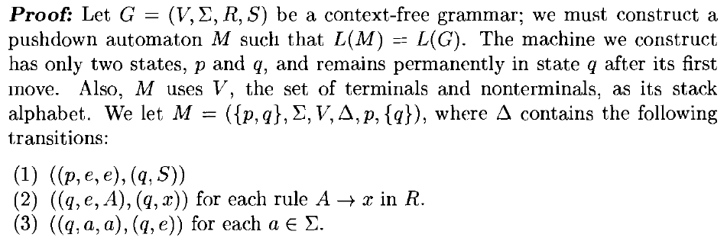
Each context-free language is accepted by some pushdown automaton

Slide 35
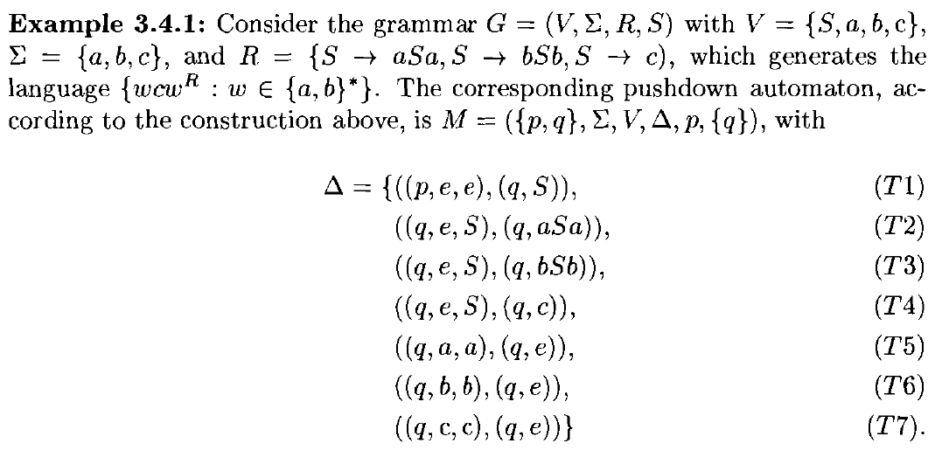
CFG to Pushdown Automaton

Slide 36
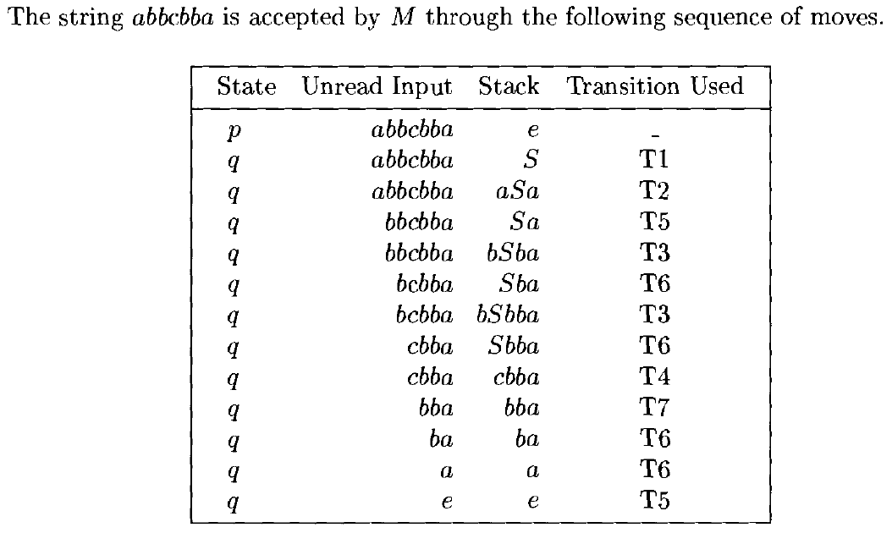
CFG to Pushdown Automaton

Slide 37
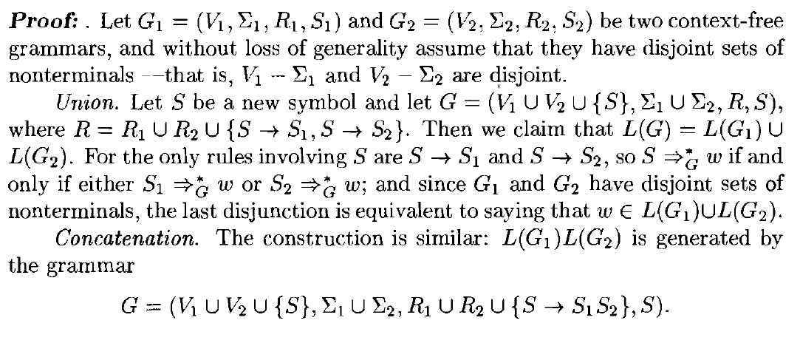
Closure Properties of Context-Free Grammar
Theorem: The context-free languages are closed under union, concatenation, and Kleene star

Slide 38
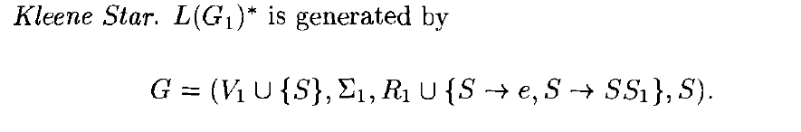
Closure Properties of Context-Free Grammar
The class of context-free languages is not closed under intersection or complementation

Slide 39
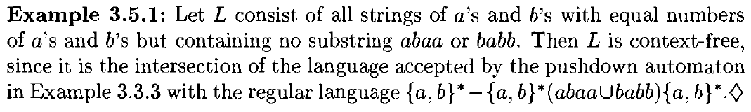
Languages that are and are not Context-Free
Theorem: The intersection of a context-free language with a regular language is a context-free language.

Slide 40
Pumping Theorem
Let G = (V, Σ, R, S) be a context-free grammar
Fanout of G, denoted Φ(G)
Largest number of symbols on the right-hand side of any rule in R.
Path in a parse tree, length and height
Lemma: The yield of any parse tree of G of height h has length at most Φ(G)^{h}
The parse tree of any string w ϵ L(G) with Iwl > Φ(G)^{h} must have a path longer than h.

Slide 41
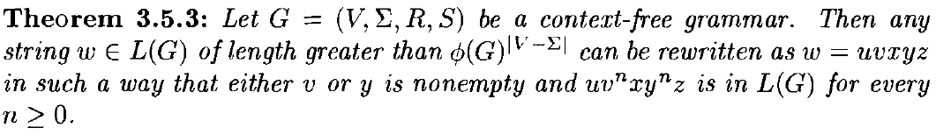
Pumping Theorem
Let T be the parse tree with root S and with yield w that has the smallest number of leaves among all parse trees with the same root and yield.
Since T's yield is longer than Φ(G)^{h}, it follows that T has a path of length at least IV - ΣI + 1, that is, with at least IV - ΣI + 2 nodes.
Only one of these nodes can be a terminal, and remaining are nonterminals.
Since there are more nodes in the path than there are nonterminals, there are two nodes on the path labeled with the same member A of IV - ΣI .

Slide 42
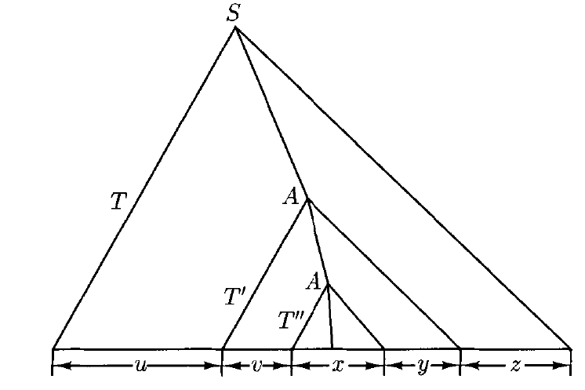
Pumping Theorem

Slide 43
Pumping Theorem
The part of T’ excluding T’’ can be repeated any number of times, including zero times, to produce other parse trees of G, whose yield is any string of the form uv^{n}xy^{n}z , n >= 0
This theorem is useful for showing that certain languages are not context-free.
Example, L = {a^{n}b^{n}c^{n} : n >=0} is not context-free

Slide 44
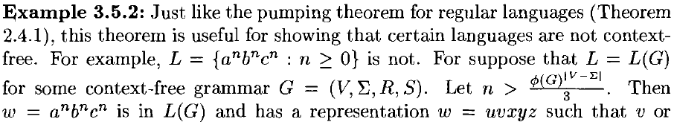
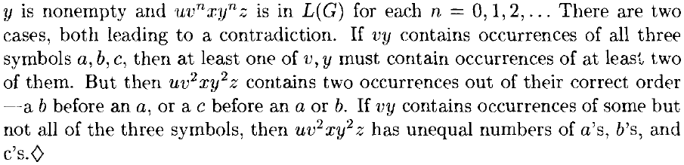

Slide 45

Languages that are and are not Context-Free
The language L = {w ϵ {a, b, c}*: w has an equal number of a's, b's, and c's} is not context-free
If L were context-free, then so would be its intersection with the regular set a*b*c*. But this language, {a^{n}b^{n}c^{n} : n >=0}, was just shown to be non-context-free

Slide 46

Closure Properties of Context-Free Grammar

Slide 47
Simplification of Context-Free Grammar
Normal Forms
Chomsky Normal Form (CNF)
See notes

Slide 48
Determinism and Parsing
Top-down Parsing
Bottom-up Parsing

